Slide 1
Supporting Mobile VR in LTE Networks:
How Close are We?
Zhaowei Tan, Yuanjie Li, Qianru Li,
Zhehui Zhang, Zhehan Li, Songwu Lu

Slide 2

Booming Virtual Reality Market
We witness a boom in Virtual Reality (VR)
$4.9B Revenue in 2017
21M hardware sold in 2017
Projected $40B Market by 2020
(Source: Orbit Research & Superdata Research)

Slide 3
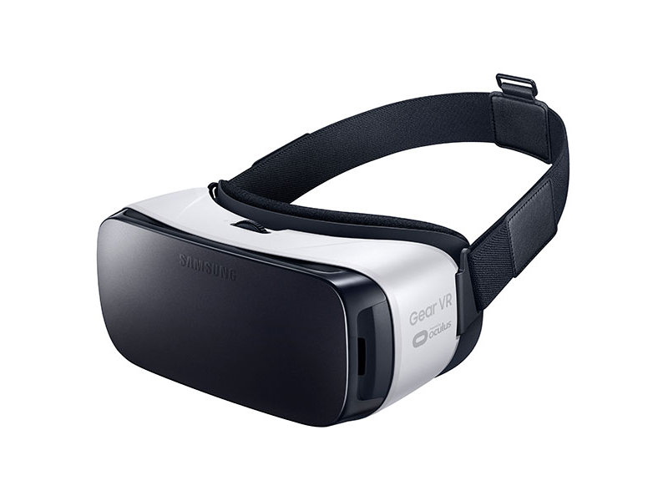
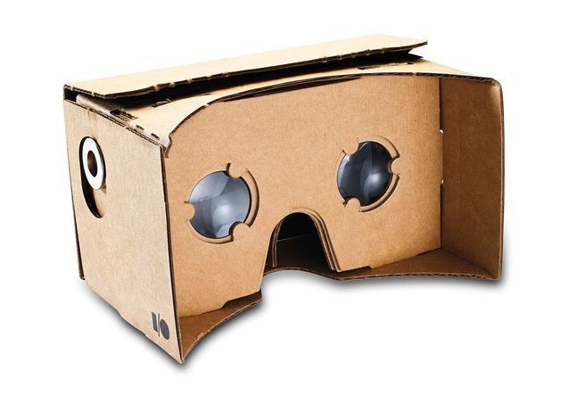
Mobile Virtual Reality
Samsung
Gear VR
Google
Cardboard
Advantages of Mobile VR
Affordable price
($20-$100 per unit)
Excellent convenience
(No wiring required)
8M
10M
Units Sold Until 2018

Slide 4




Users’ Demand for Mobile VR
Anywhere, anytime
(outdoor/indoor, static/mobile)
High fidelity
(≥1080p, ≥60FPS, low latency)
2. Graphical
Processing
4. Display
Edge-based Scheme over Mobile Networks
1. User Pose
(from sensors)
3. Frame
Transfer

Slide 5
Mobile VR over LTE Network
4G LTE:
The largest mobile network infrastructure for “anywhere, anytime” Internet services
LTE
2. Graphical
Processing
4. Display
Edge-based Scheme over Mobile Networks
1. User Pose
(from sensors)
3. Frame
Transfer

Slide 6

How LTE Network Works
Radio
Core
2. Graphical
Processing
4. Display
3. Frame
Transfer
1. User Pose
(from sensors)

Slide 7
How LTE Network Works
Radio Resource Control
{
Radio Link Control
Control Signaling
Link Layer
Link layer
Media Access Control
Physical Layer
Control Signaling

Slide 8
Can LTE Support Mobile VR?
Key Challenge: Network Latency
For human tolerance: Should not exceed 25ms
This talk:
  Does 4G LTE have the potential to enable VR?
  What are the roadblocks for mobile VR over LTE?
  What are the possible solutions to the roadblocks?

Slide 9
1. Does LTE have the potential?

Slide 10
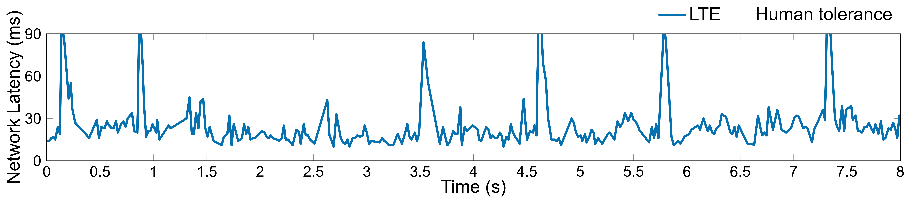
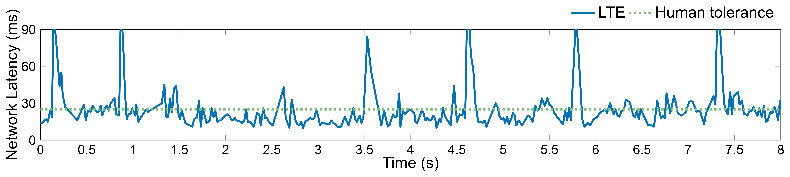
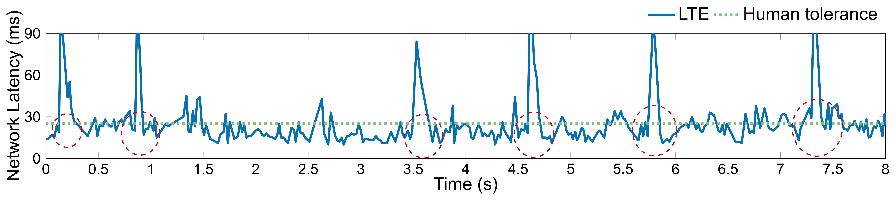
A First Look at VR over LTE
  LTE exhibits signs to meet latency requirement for medium quality VR
  User regularly experiences long latency

Slide 11
2. What are the roadblocks?

Slide 12


Analysis Methodology
Challenge: LTE is a closed “black-box” system
Our approach:
Standard Analysis
“Black-box”
Device-Side Empirical Study
LTE
Identify latency deficiencies
Derive equations for latency
8-month empirical study
Verizon, AT&T, T-Mobile, Sprint
3M LTE messages+21M packets

Slide 13
Five Intuitions for VR over LTE
  Wireless bandwidth is the bottleneck for VR
  LTE can quickly recover wireless data corruption
  Device receives new data immediately after handover
  Uplink motions are quickly sent to the base station
  Handover in LTE incurs unnoticeable latency

Slide 14
Five Intuitions for VR over LTE
  Wireless bandwidth is the bottleneck for VR.
  LTE can quickly recover wireless data corruption
  Device receives new data immediately after handover
  Uplink motions are quickly sent to the base station
  Handover in LTE incurs unnoticeable latency
We invalidate all of them!

Slide 15
Overview of Findings
  Wireless bandwidth is the bottleneck for VR.
  LTE can quickly recover wireless data corruption
  Device receives new data immediately after handover
  Uplink motions are quickly sent to the base station
  Handover in LTE incurs unnoticeable latency
Sufficient bandwidth for medium quality VR
LTE signaling operations contribute a bulk portion of latency
Inter-protocol incoordination
Single-protocol deficiency

Slide 16
Sufficient Bandwidth for Medium-Quality VR
Bandwidth
Inter-Protocol
Single-Protocol
Misunderstanding:
Wireless bandwidth is the bottleneck for VR.
Reality: Sufficient LTE bandwidth for mobile VR!
Insight: Simply improving bandwidth is not enough
Uplink
Downlink

Slide 17
Inter-Protocol Incoordination:
Head-of-Line Blocking in Mobility
Bandwidth
Inter-Protocol
Single-Protocol
Misunderstanding:
Device receives new data immediately after handover
Reality: Duplicate data incurs head-of-line blocking!
61% – 92% handover incurs head-of-line blocking
30.0 – 44.7ms head-of-line blocking latency
80ms at maximum

Slide 18





Inter-Protocol Incoordination:
Head-of-Line Blocking in Mobility
Bandwidth
Inter-Protocol
Single-Protocol
Root Cause: Problematic interplay between radio link control and radio resource control
ACK
Insight: Radio link control should be handover friendly for mobile VR

Slide 19
Single-Protocol Deficiency:
Latency-Unfriendly Control Channel
Bandwidth
Inter-Protocol
Single-Protocol
Misunderstanding:
The user motion will be quickly sent out to the edge
Reality: 81% uplink packets perceive 6-9ms extra delay!

Slide 20



Single-Protocol Deficiency:
Latency-Unfriendly Control Channel
Bandwidth
Inter-Protocol
Single-Protocol
Root Cause: Scheduling-based latency-unfriendly uplink control channel protocol design
Scheduling request
Radio grant
Data transmission

Slide 21
Single-Protocol Deficiency:
Latency-Unfriendly Control Channel
Bandwidth
Inter-Protocol
Single-Protocol
Root Cause: Scheduling-based latency-unfriendly uplink control channel protocol design
Fundamental tradeoff between
resource utilization and uplink latency

Slide 22
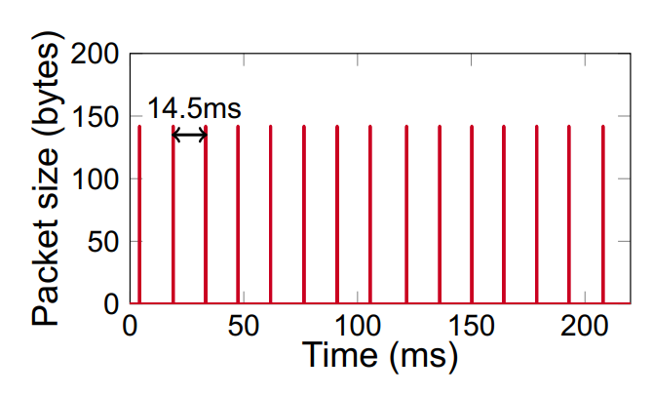
Single-Protocol Deficiency:
Latency-Unfriendly Control Channel
Bandwidth
Inter-Protocol
Single-Protocol
Root Cause: Scheduling-based latency-unfriendly uplink control channel protocol design
Insight: The general latency-utilization tradeoff can be bypassed by periodic VR traffic
Periodic VR uplink traffic

Slide 23
Summary: How Problems Happen
Problematic and slow signaling protocol interplays
  Well-designed single protocol ≠ Proper protocol interplays
Extra delays from each protocol’s signaling actions
  Unnoticeable in general, but critical for mobile VR
The LTE network protocols are unaware of mobile VR’s traffic patterns

Slide 24
3. What are the solutions?

Slide 25
LTE-VR: LTE Booster for Mobile VR
Mitigating inter-protocol latency
Masking intra-protocol latency
Mobile Phone
Client Side
Cross-layer design
Side-channel info
A device-centric approach
  Only the device side has enough message
  No expensive infrastructure side update

Slide 26





Mitigate Head-of-Line Blocking
Inter-Protocol
Single-Protocol
Strawman solution: Immediately acknowledge every received VR data
Challenge: Excessive signaling messages
ACK
ACK
ACK
ACK
ACK
ACK
ACK
ACK
ACK
ACK

Slide 27
Mitigate Head-of-Line Blocking
Inter-Protocol
Single-Protocol
Strawman solution: Immediately acknowledge every received VR data
Challenge: Excessive signaling messages
Solution:
Selective feedback using handover prediction
Measurement:
RSSI_{bs2}>RSSI_{bs1}
Prediction:
Handover to BS2
ACK
ACK
ACK
ACK
ACK
ACK

Slide 28
Mask Uplink Control Latency
Inter-Protocol
Single-Protocol
Strawman: Allocate resource before VR data arrives
Challenge: Potential resource waste
Scheduling request
Radio grant
Data transmission
Wasted
Scheduling request
Radio grant
Data transmission

Slide 29
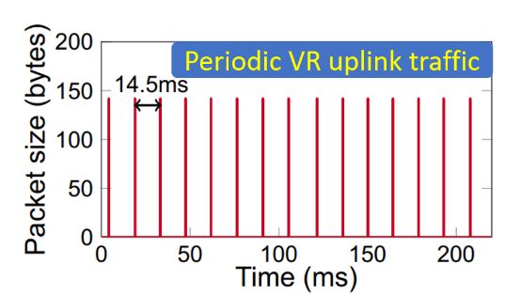
Mask Uplink Control Latency
Inter-Protocol
Single-Protocol
Solution:
Proactive allocation using VR traffic prediction
Strawman: Allocate resource before VR data arrives
Challenge: Potential resource waste
VR traffic arrival prediction
Scheduling request
Radio grant
Data transmission

Slide 30
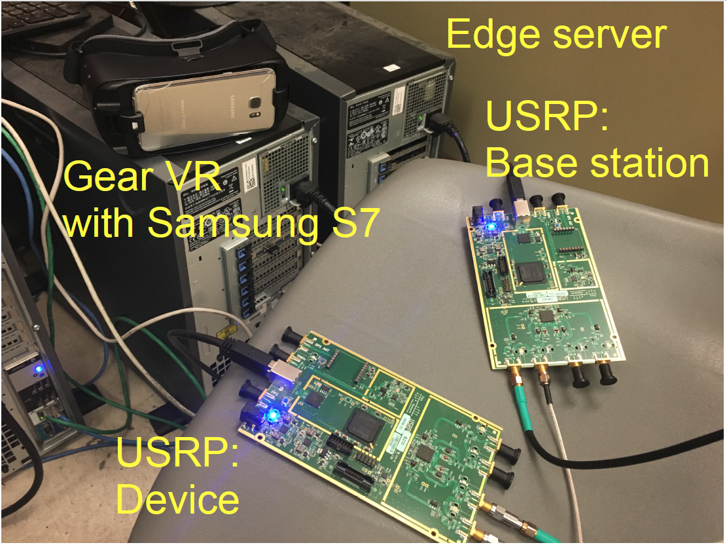
Implementation and Prototype
Software implementation in device radio firmware
  No hardware modification
Approximative prototype with OpenAirInterface and Universal Software Radio Peripheral (USRP)
  Firmware not open-sourced to academia

Slide 31
Evaluation
Can LTE-VR meet mobile VR’s latency demands?
How much overhead does LTE-VR occur?
Can LTE-VR be used in 5G?

Slide 32
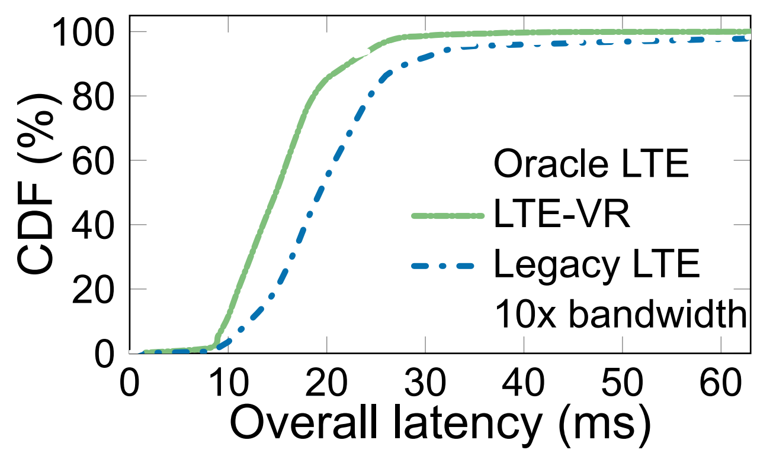
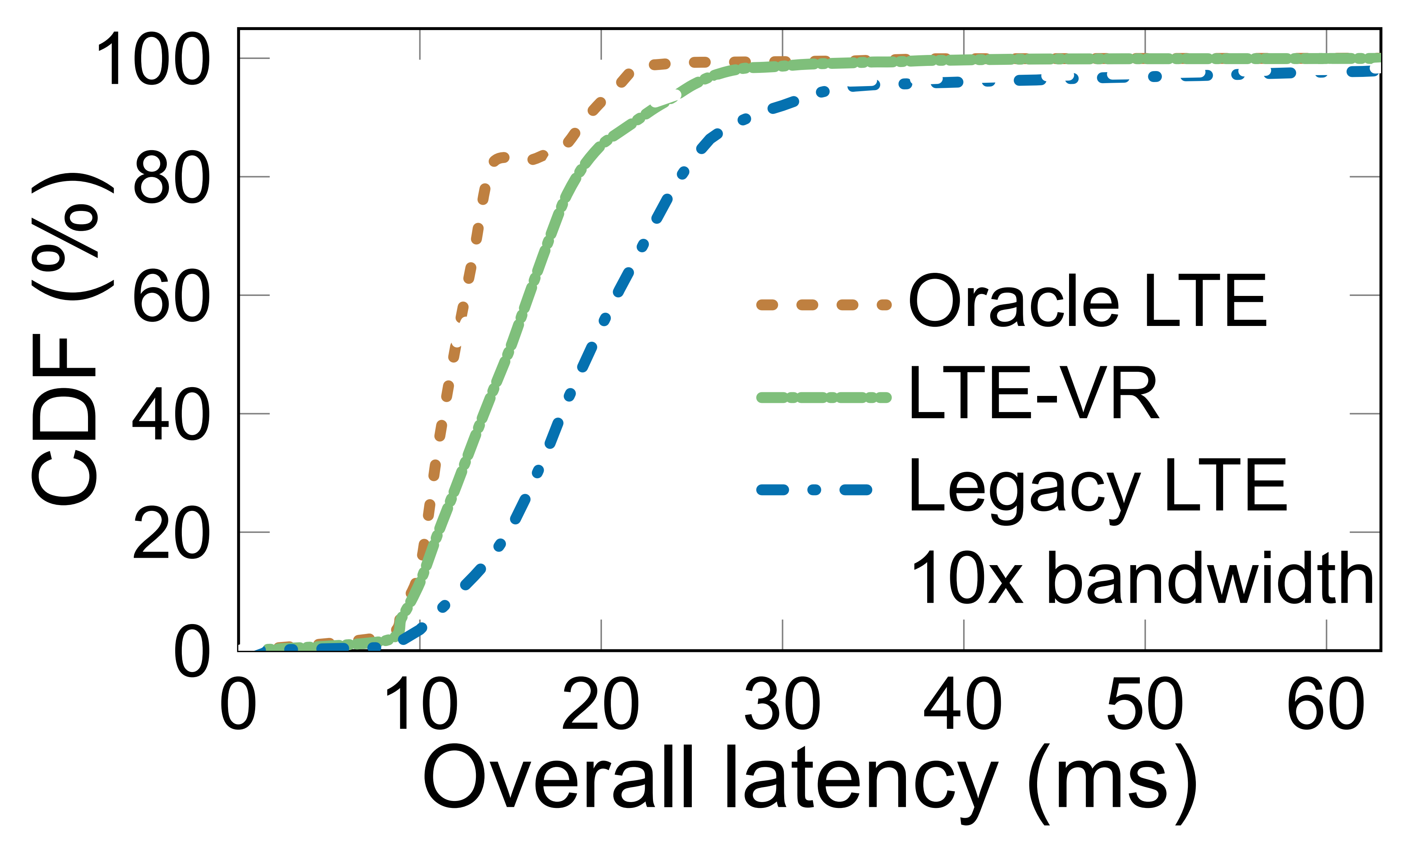
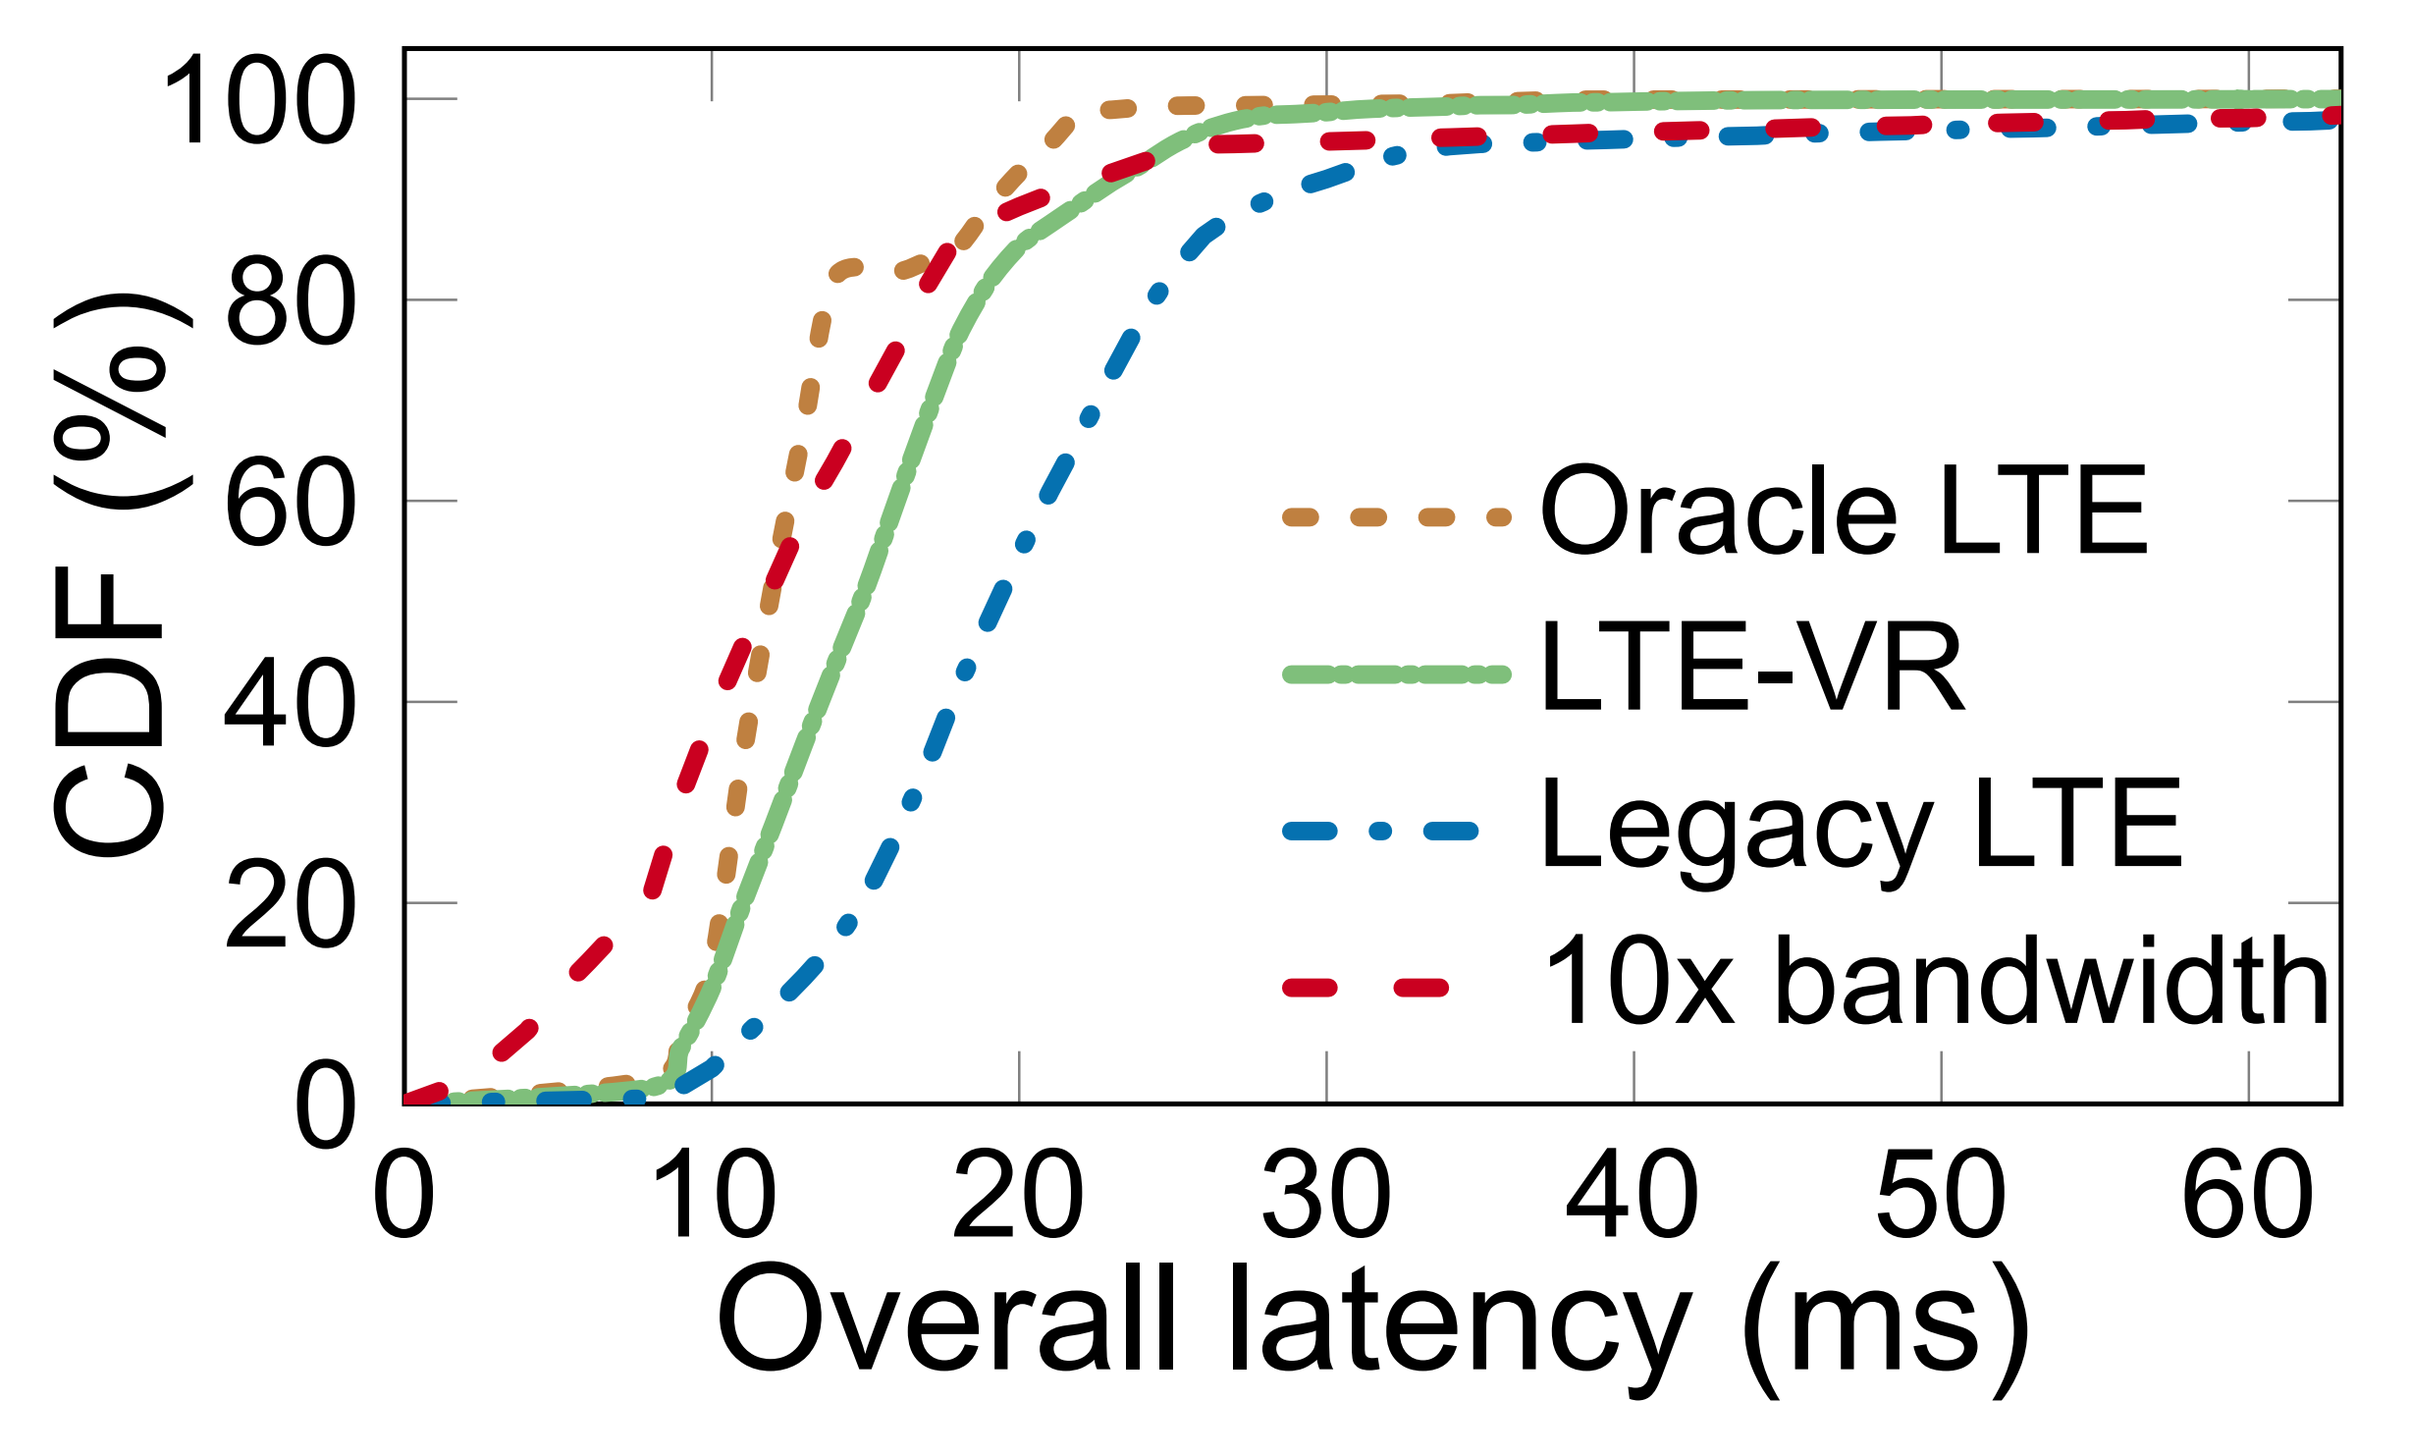
Can LTE-VR Meet VR’s Demands?
Yes: Meet delay tolerance with 95% probability
  Reduce latency outlier frames by 3.7x
Approximate oracle LTE
Comparable to 10x bandwidth expansion

Slide 33
How Much is the Overhead?
4% - 8% signaling messages
0.1% downlink throughput
2.3% extra uplink grants
Negligible overhead!
LTE-VR leverages phone-side information to reduce the overhead as much as possible

Slide 34
Can LTE-VR be Used in 5G?
Yes!
Complimentary to existing 5G radio technologies*
  Up to 31x improvement on latency outliers
Provides insights on 5G signaling design
  Most 5G signaling designs so far inherits 4G counterparts
Applicable to other latency-sensitive apps
  Augmented reality, autonomous driving, gaming, …

Slide 35
Summary
LTE is promising for mobile VR, but not perfect
  High bandwidth ≠ low latency
  This work: Demystify 5 misunderstandings
LTE-VR: An in-device LTE booster for mobile VR
  Only the device has the info for VR latency reduction
Still a long voyage toward ultra-low latency 5G

Slide 36
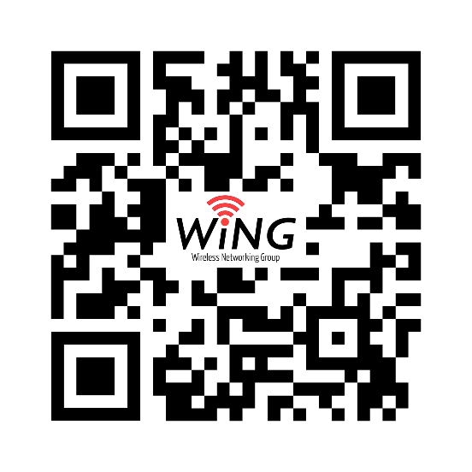
Thank you!
For code and dataset: http://metro.cs.ucla.edu/mobileVR.html

